Slide 1
Civic Engagement
Presented by: Lilla Ball

Slide 2

What is Civic Engagement?
Thomas Ehrlich defines civic engagement as:
Working to make a difference in the civic life of our communities.
Developing the combination of:
-Knowledge
-Skills
-Values and Motivation
To make that difference promoting the quality of life in a community through:
-Political and Non-Political processes

Slide 3

2. QEP: Civic Engagement at PVCC
PVCC accreditation requires:
Implementation of a Quality Enhancement Project(QEP), the current PVCC QEP is “Civic Engagement”

Slide 4

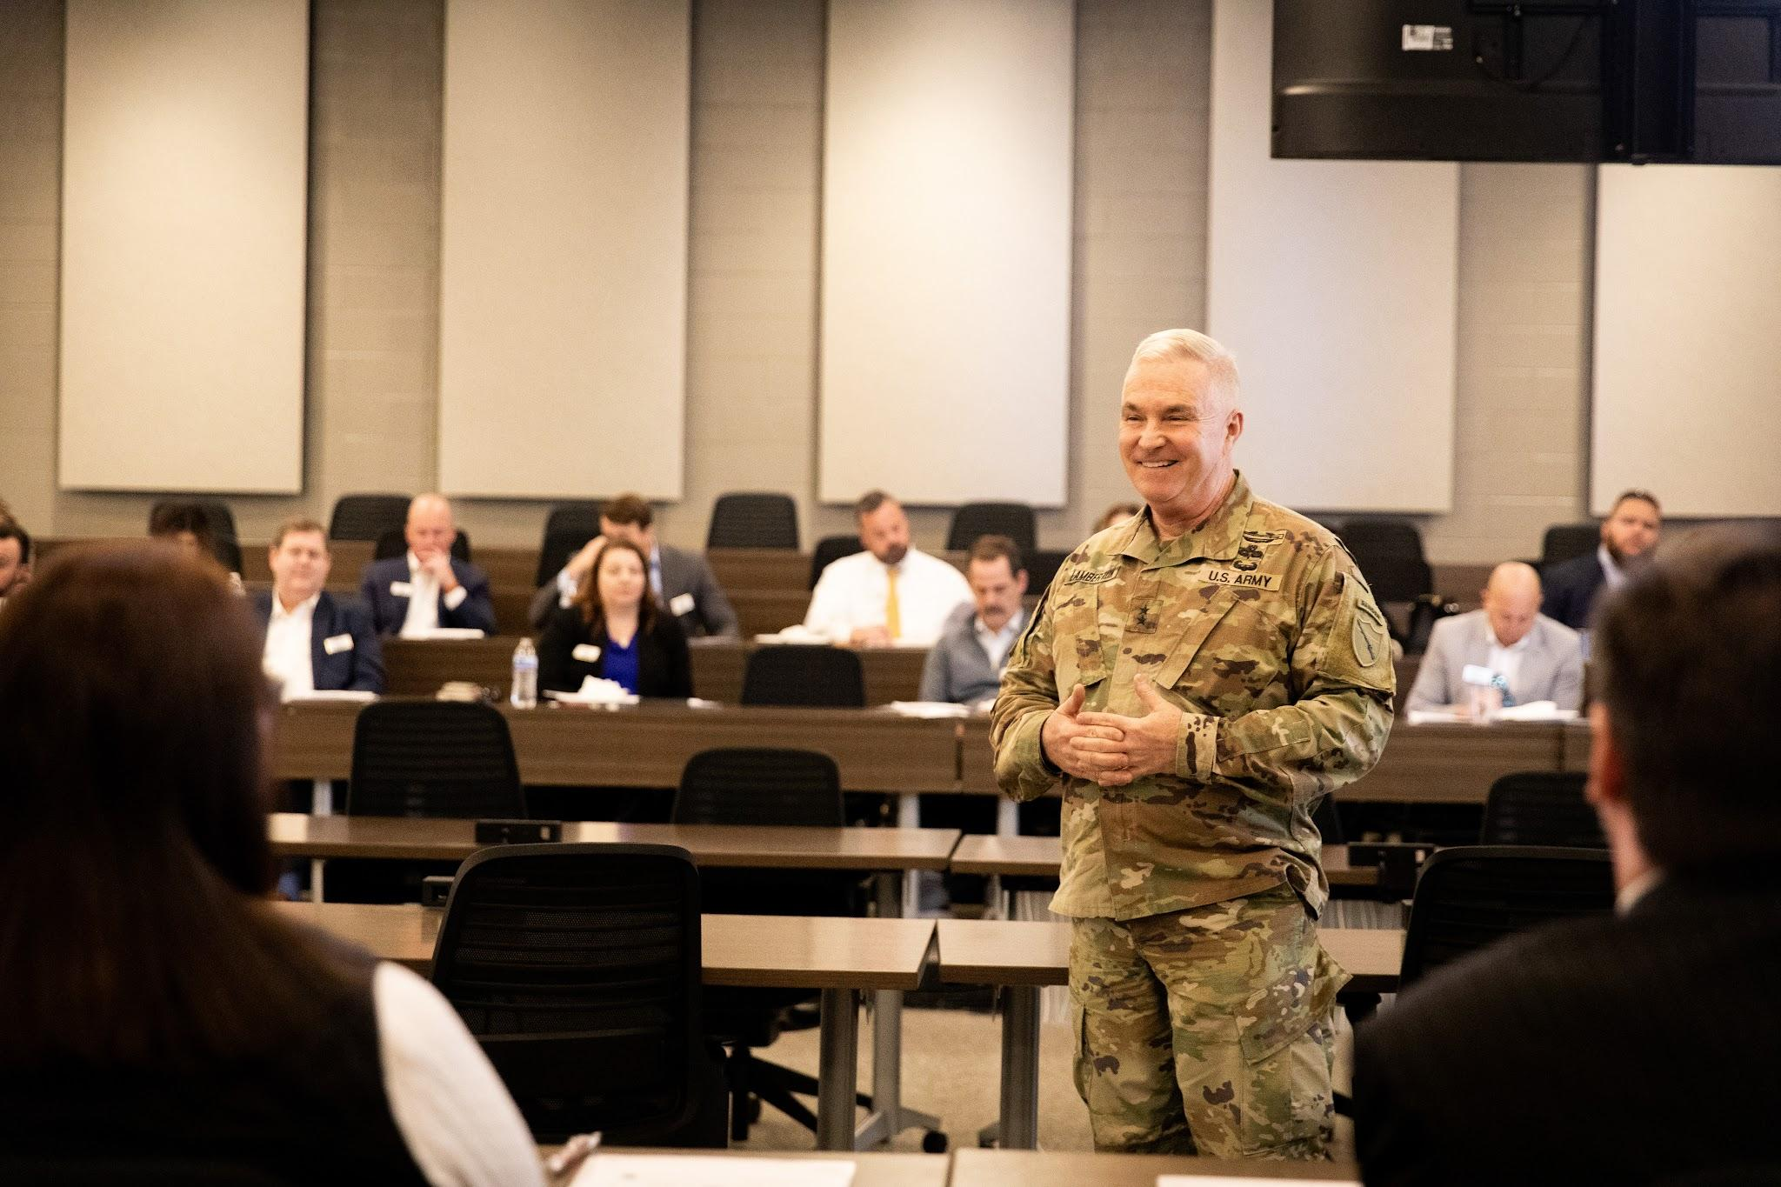
3. PVCC QEP “Civic Engagement” Title:
“Civic Sense: Engaging Students in the Civic Life of their Communities”
Web page: https://www.pvcc.edu/campus-life/civic-sense

Slide 5
4. “Civic Sense” QEP Vision Statement
Engaging Students in the civic life of their communities
“Civic Sense”
-Seeks to build student leaders: who have strong commitment to democracy and who engage in the civic life of their communities through: collaborative,creative, and critical problem solving even after graduating from pvcc.

Slide 6

5. PVCC “Civic Sense” Student Learning Outcomes(SLOs)
PVCC Graduates will:
SLO1: Actively participate in civic life by voting in
-Local, State, and Federal elections
SLO2: Actively participate in civic life by:
-Engaging in public service and/or other activities that improve: The condition of people's lives and/or the quality of people's lives.
SLO3: Evaluate multiple perspectives to:
-Think critically about issues of public consequence.

Slide 7

7. Reference
This material is from: Ehrlich, T. (Ed.). (2000). Civic Responsibility and Higher education Westport, CT: American Council on Education.

